Slide 1
Decision Trees
11-6-2023

Slide 2
Model?
Tree
Each internal node (including the root) represents a question focused on one attribute.
Children of a node correspond to different answers for that question.
Each leaf node represents the subset of training data corresponding to the sequence of answers along the path from the root to that leaf.

Slide 3
Tree terminology
Root
Leaf
Internal node
Branch
Frontier: a set of nodes, none of which is the ancestor of another.

Slide 4
Binary Variables
Questions asked evaluate whether a variable value is True or False, e.g.,
Tall?
Heavy?
Green?

Slide 5
Numeric Variables
Questions asked compare the value of a variable to a number, e.g.,
x>3
y<3.2
z >= 1.7
When shown on a figure or graph, each of these is analogous to drawing a line, plane, or hyperplane parallel to one of the axes!

Slide 6
Discrete Variables
1. Questions asked interrogate the value of a variable, e.g.,
“Pixel color” may take 3 values (R, B, G), with each leading to a different child of that internal node.
“Height” may take 5 values (very low, low, medium, high, very high)
2. Some values may be aggregated if they belong together, e.g.,
“Height for basketball” in {very low, low, medium} vs. {high, very hight}
“Country region” in {Mexico} vs. {Panama, Nicaragua, Guatemala} vs. {Colombia, Brazil, Venezuela} …

Slide 7

A two-class classification problem in 2 dimensions

Slide 8









A two-class classification problem in 2 dimensions: best solution using clustering

Slide 9

A two-class classification problem in 2 dimensions: best solution using Perceptron (or logistic regression)

Slide 10

A two-class classification problem in 2 dimensions: best solution using neural network (with 2 hidden nodes)
Notes:
One line from one hidden node and another line from another hidden node

Slide 11


A two-class classification problem in 2 dimensions: best solution using decision trees

Slide 12

A two-class classification problem in 2 dimensions: best solution using decision trees
Notes:
Here the splits might be 3. Decision trees created using RF and selected different features(combination) the above conclusion can be obtained

Slide 13
How does the decision tree solution differ from the neural network (with two hidden nodes)
Hidden nodes can represent lines of any orientation, e.g., 80 degrees from horizontal, e.g., x+5y>2.
Decision tree nodes represent only horizontal or vertical lines, e.g., x>2.
Tradeoff: expressive power vs. ease of learning
Each node of the decision tree is much simpler than the hidden node of an NN, hence “learning” is easier, although it is less expressive.
Variations of decision trees such as “oblique trees” resemble neural networks in their behavior.

Slide 14
Decision trees as logical expressions
Each internal node is an “if-then-else”, e.g.,
If (y<1)
Then class X
Else if (x<1)
Then class X
Else if (x<4)
Then class O
Else class X

Slide 15
Decision trees as case statements
Each internal node poses a multi-valued question for one variable e.g.,
Case y:
Less than 1: class X
Greater than 4: class X
Otherwise Case x:
Less than 1: class X
Otherwise class Y

Slide 16
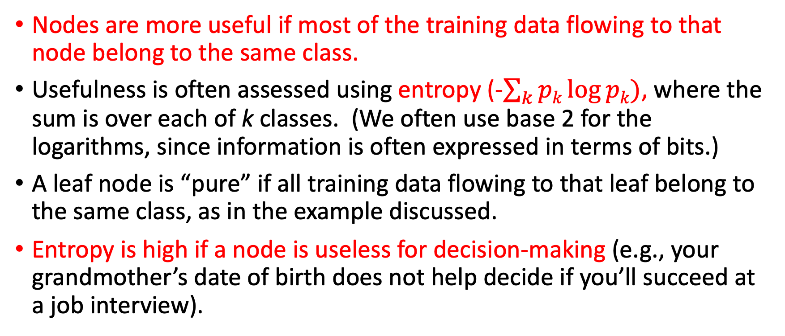
Assessing nodes for classification problems
Nodes are more useful if most of the training data flowing to that node belong to the same class.
Usefulness is often assessed using entropy (-$\sum_{k}{pk\log{pk)}}$, where the sum is over each of k classes. (We often use base 2 for the logarithms, since information is often expressed in terms of bits.)
A leaf node is “pure” if all training data flowing to that leaf belong to the same class, as in the example discussed.
Entropy is high if a node is useless for decision-making (e.g., your grandmother’s date of birth does not help decide if you’ll succeed at a job interview).

Slide 17
Example: three possible entropy values associated with a node
If a node is associated with 5 training data points from one class and 0 training data points from the other class, the associated entropy is –(5/5)(log 5/5) - (0/5)(log 0/5) = 0
But if a node is associated with 3 training data from one class and 2 training data points from the other class, the associated entropy is –(3/5)(log 3/5) - (2/5)(log 2/5) = 0.44+0.53 = 1.02 approx.
If a node is associated with 4 training data from one class and 1 training data points from the other class, the associated entropy is –(4/5)(log 4/5) - (1/5)(log 1/5) = 0.13+0.46 = 0.59 approx.

Slide 18
Which question to ask and when?
Suppose you have already asked a few questions and obtained some answers.
What is the next question to ask?
If there are five attributes, and each is binary, there are 32 possibilities.
Some are clearly useless, e.g., repeating a question.
The most useful questions reduce uncertainty the most.
Information Gain = (entropy before asking the question) – (entropy after asking the question).

Slide 19
Combining the entropy from both children of an internal binary node in the decision tree
Assume we have ten training data points, of which five belong to each class (A vs. B) Compare two alternatives:
Yes branch: (5A, 4B), No branch: (0A, 1B)
Yes branch: (4A, 1B), No branch: (1A, 4B)

Slide 20
Combining the entropy from both children of an internal binary node in the decision tree
At some point in the tree, assume we have ten training data points, of which five belong to each class (A vs. B). Compare two alternatives:
Yes branch: (5A, 4B) taken with 9/10 probability, No branch: (0A, 1B) taken with 1/10 probability.
Entropy for yes child=0.47+0.52=0.99
Entropy for no child = 0
Combined entropy= (0.9)(0.99)+(0.1)(0) = 0.9 approx.
Yes branch: (4A, 1B), No branch: (1A, 4B), each taken with 5/10 probability.
Entropy for yes child=0.26+0.46=0.72
Entropy for no child = 0.46+0.26 = 0.72
Combined entropy= (0.5)(0.72)+(0.5)(0.72) = 0.72
The second alternative is better; we take a weighted combination using the relative number of data points for each child node.

Slide 21
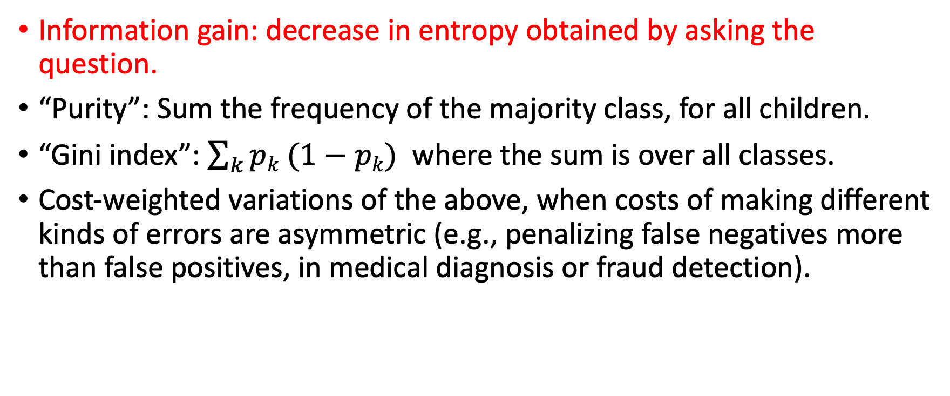
Criteria to choose between alternative questions
Information gain: decrease in entropy obtained by asking the question.
“Purity”: Sum the frequency of the majority class, for all children.
“Gini index”: $\sum_{k}{pk (1−pk)}$ where the sum is over all classes.
Cost-weighted variations of the above, when costs of making different kinds of errors are asymmetric (e.g., penalizing false negatives more than false positives, in medical diagnosis or fraud detection).

Slide 22
Decision Tree Learning Algorithms
These are incremental solution construction algorithms: we start with nothing, and build up the solution piece by piece.
The frontier begins with the root, and grows in successive iterations of the algorithm, expanding one node in the frontier at a time.
Termination criteria: too many nodes, tree is too deep, solution quality is satisfactory (perhaps for specific classes), no significant improvement observed by expanding a node.
Contrast with k-means clustering or neural network learning, where we start with a random candidate solution and improve it little by little.

Slide 23
Decision Tree Learning Algorithm (for 2-class classification)
Initially the frontier consists of just the root, associated with the entire training data set.
While (tree is not too big, and solution quality is unacceptable, and the recent iteration has resulted in significant improvement):
For each node in the frontier,
For each possible question that can be asked at that node,
Evaluate the information gain;
Choose the question that results in most information gain;
Ask the question for the node that results in most information gain.
End While;
Prune the tree until the tree size is satisfactory, eliminating questions that have not resulted in sufficient improvement;
End.

Slide 24
Efficiency considerations
Previously computed values are stored and reused.
When the frontier is large, the storage requirements are high.
Limits may be imposed on tree depth, e.g., 5 times the problem dimensionality.
To reduce search space, attention may be restricted to questions focused on:
attributes not recently considered; or
node in the frontier with the highest entropy; or
node in the frontier with the largest number of training data points.

Slide 25
Variations
CART
ID3
C4.5
…

Slide 26
Applying decision trees to regression problems
At each node, predict the output to be the average of all the training data points associated with that node.
Instead of entropy, the criterion (to choose between possible questions) is MSE.
For each problem dimension, we must consider each possible split (between neighbor pairs) to determine the best.

Slide 27
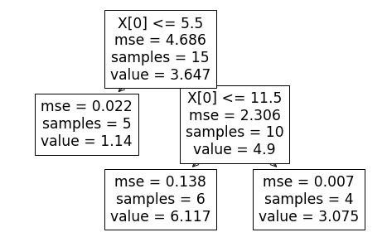
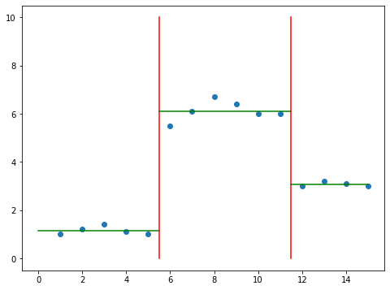
Example: regression using decision tree, with one input dimension

Slide 28
Main advantages of using decision trees
Explainability; each node asks a very simple question.
Higher level nodes represent useful features; feature selection is automatically performed.
Trees can be written using “if-then-else” format, which is intuitively understandable for non-technical domain experts—hence they can “validate” saying whether the resulting tree is reasonable from their perspective.

